Slide 1
CHAPTER 13
Chi-Square Applications
to accompany
Introduction to Business Statistics
seventh edition, by Ronald M. Weiers
Presentation by Priscilla Chaffe-Stengel
Donald N. Stengel
© 2011 Cengage Learning.
All Rights Reserved. May not be scanned, copied, or duplicated, or posted to a publicly accessible website, in whole or in part.

Slide 2
Chapter 13 - Learning Objectives
Explain the nature of the chi-square distribution.
Apply the chi-square distribution to:
  Goodness-of-fit tests
  Tests of independence between two variables
  Tests comparing proportions from multiple populations
  Tests of a single population variance.
© 2011 Cengage Learning.
All Rights Reserved. May not be scanned, copied, or duplicated, or posted to a publicly accessible website, in whole or in part.

Slide 3
Chapter 13 - Key Terms
Observed versus expected frequencies
Number of parameters estimated, m
Number of categories used, k
Contingency table
Independent variables
© 2011 Cengage Learning.
All Rights Reserved. May not be scanned, copied, or duplicated, or posted to a publicly accessible website, in whole or in part.

Slide 4
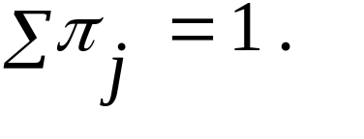
Goodness-of-Fit Tests
The Question:
  Does the distribution of sample data resemble a specified probability distribution, such as:
    the binomial, hypergeometric, or Poisson discrete distributions.
    the uniform, normal, or exponential continuous distributions.
    a predefined probability distribution.
Hypotheses:
  H₀: π_{i} = values expected H₁: π_{i} ≠ values expected
  where
© 2011 Cengage Learning.
All Rights Reserved. May not be scanned, copied, or duplicated, or posted to a publicly accessible website, in whole or in part.

Slide 5
Goodness-of-Fit Tests
Rejection Region:
  Degrees of Freedom = k – 1 – m
    where k = # of categories, m = # of parameters
    Uniform Discrete: m = 0 so df = k – 1
    Binomial: m = 0 when π is known, so df = k – 1
    m = 1 when π is unknown, so df = k – 2
    Poisson: m = 1 since µ usually estimated, df = k – 2
    Normal: m = 2 when µ and σ estimated, df = k – 3
    Exponential: m = 1 since µ usually estimated, df = k – 2
© 2011 Cengage Learning.
All Rights Reserved. May not be scanned, copied, or duplicated, or posted to a publicly accessible website, in whole or in part.

Slide 6
Goodness-of-Fit Tests
Test Statistic:
where O_{j} = Actual number observed in each class
E_{j} = Expected number, π_{j} • n
(
O
–
E
)
2
2
=
j
j
χ
∑
E
j
© 2011 Cengage Learning.
All Rights Reserved. May not be scanned, copied, or duplicated, or posted to a publicly accessible website, in whole or in part.

Slide 7
Goodness-of-Fit: An Example
Problem 13.18: It has been reported that 10.3% of U.S. households do not own a vehicle, with 34.2% owning 1 vehicle, 38.4% owning 2 vehicles, and 17.1% owning 3 or more vehicles. The data for a random sample of 100 households in a resort community are summarized below. At the 0.05 level of significance, can we reject the possibility that the vehicle-ownership distribution in this community differs from that of the nation as a whole?
# Vehicles Owned # Households
0 20
1 35
2 23
3 or more 22
© 2011 Cengage Learning.
All Rights Reserved. May not be scanned, copied, or duplicated, or posted to a publicly accessible website, in whole or in part.

Slide 8
Goodness-of-Fit: Problem 13.18, cont.
# Vehicles O_{j} E_{j} [O_{j}– E_{j} ]²/ E_{j}
0 20 10.3 9.134951
1 35 34.2 0.018713
2 23 38.4 6.176042
3+ 22 17.1 1.404094
Sum = 16.733800
I. H₀: π₀ = 0.103, π₁ = 0.342, π₂ = 0.384, π₃₊ = 0.171
Vehicle-ownership distribution in this community is the same as it is in the nation as a whole.
H₁: At least one of the proportions does not equal the stated value. Vehicle-ownership distribution in this community is not the same as it is in the nation as a whole.
© 2011 Cengage Learning.
All Rights Reserved. May not be scanned, copied, or duplicated, or posted to a publicly accessible website, in whole or in part.

Slide 9
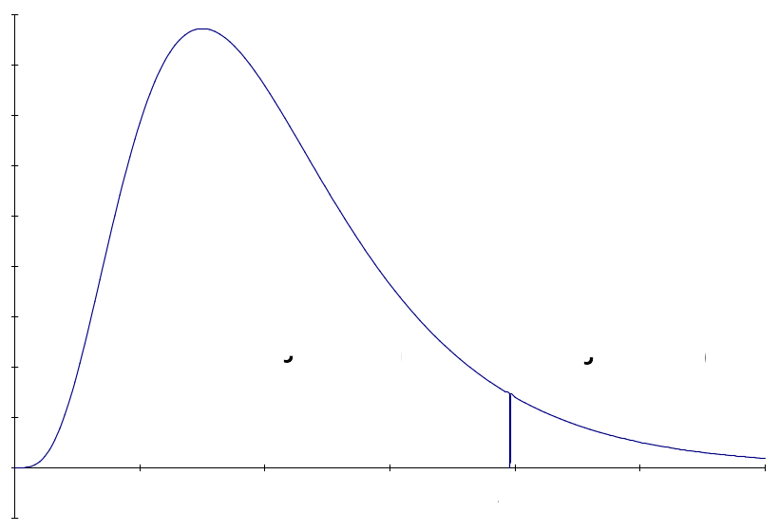
Goodness-of-Fit: Problem 13.18, cont.
II. Rejection Region:
α = 0.05
df = k – 1 – m = 4 – 1 – 0 = 3
III. Test Statistic:
χ² = 16.7338
IV. Conclusion: Since the test statistic of χ² = 16.7338 falls well above the critical value of χ² = 7.815, we reject H₀ with at least 95% confidence.
V. Implications: There is enough evidence to show that vehicle ownership in this community differs from that in the nation as a whole.
© 2011 Cengage Learning.
All Rights Reserved. May not be scanned, copied, or duplicated, or posted to a publicly accessible website, in whole or in part.

Slide 10
Chi-Square Tests of Independence
Between Two Variables
The Question:
  Are the two variables independent? If the two variables of interest are independent, then
    the way elements are distributed across the various levels of one variable does not affect how they are distributed across the levels of the other.
    the probability of an element falling in any level of the second variable is unaffected by knowing its level on the first dimension.
© 2011 Cengage Learning.
All Rights Reserved. May not be scanned, copied, or duplicated, or posted to a publicly accessible website, in whole or in part.

Slide 11
An Integrated Definition of Independence
From basic probability:
  If two events are independent
  P(A and B) = P(A) • P(B)
In the Chi-Square Test of Independence:
  If two variables are independent
  P(row_{i} and column_{j}) = P(row_{i}) • P(column_{j})
© 2011 Cengage Learning.
All Rights Reserved. May not be scanned, copied, or duplicated, or posted to a publicly accessible website, in whole or in part.

Slide 12
Chi-Square Tests of Independence
Hypotheses:
  H₀: The two variables are independent.
  H₁: The two variables are not independent.
Rejection Region:
  Degrees of freedom = (r – 1) (k – 1)
Test Statistic:
(
O
–
E
)
2
χ
2
=
∑
∑
ij
ij
E
ij
© 2011 Cengage Learning.
All Rights Reserved. May not be scanned, copied, or duplicated, or posted to a publicly accessible website, in whole or in part.

Slide 13
Chi-Square Tests of Independence
Calculating expected values
E
=
P
(
row
and
column
)
⋅
n
=
P
(
row
)
⋅
P
(
column
)
⋅
n
ij
i
j
i
j
#
elements
in
row
#
elements
in
column
=
i
⋅
j
⋅
n
n
n
Canceling
two
factors
of
n
,
(#
elements
in
row
)
⋅
(
#
elements
in
column
)
=
i
j
E
ij
n
© 2011 Cengage Learning.
All Rights Reserved. May not be scanned, copied, or duplicated, or posted to a publicly accessible website, in whole or in part.

Slide 14
Chi-Square Tests of Independence
An Example, Problem 13.35: Researchers in a California community have asked a sample of 175 automobile owners to select their favorite from three popular automotive magazines. Of the 111 import owners in the sample, 54 selected Car and Driver, 25 selected Motor Trend, and 32 selected Road & Track. Of the 64 domestic-make owners in the sample, 19 selected Car and Driver, 22 selected Motor Trend, and 23 selected Road & Track. At the 0.05 level, is import/domestic ownership independent of magazine preference? Based on the chi-square table, what is the most accurate statement that can be made about the p-value for the test?
© 2011 Cengage Learning.
All Rights Reserved. May not be scanned, copied, or duplicated, or posted to a publicly accessible website, in whole or in part.

Slide 15
Chi-Square Tests of Independence
First, arrange the data in a table.
Car and Motor Road &
Driver (1) Trend (2) Track (3) Totals
Import (Imp) 54 25 32 111
Domestic (Dom) 19 22 23 64
Totals 73 47 55 175
Second, compute the expected values and contributions to χ² for each of the six cells.
Then to the hypothesis test....
© 2011 Cengage Learning.
All Rights Reserved. May not be scanned, copied, or duplicated, or posted to a publicly accessible website, in whole or in part.

Slide 16
Chi-Square Tests of Independence
Car and Motor Road &
Driver (1) Trend (2) Track (3)
Import (Imp): O - 54 25 32
E - 46.3029 29.8114 34.8857
χ² contribution - 1.2795 0.7765 0.2387
Domestic (Dom) : O - 19 22 23
E - 26.6971 17.1886 20.1143
χ² contribution - 2.2192 1.3468 0.4140
 Σ χ² contributions = 6.2747
© 2011 Cengage Learning.
All Rights Reserved. May not be scanned, copied, or duplicated, or posted to a publicly accessible website, in whole or in part.

Slide 17

Chi-Square Tests of Independence
I. Hypotheses:
H₀: Type of magazine and auto ownership are
independent.
H₁: Type of magazine and auto ownership are not
independent.
II. Rejection Region:
α = 0.05
df = (r – 1) (k – 1)
= (2 – 1)• (3 – 1)
= 1 • 2 = 2
If χ² > 5.991, reject H₀.
© 2011 Cengage Learning.
All Rights Reserved. May not be scanned, copied, or duplicated, or posted to a publicly accessible website, in whole or in part.

Slide 18
Chi-Square Tests of Independence
III. Test Statistic:
χ² = 6.2747
IV. Conclusion:
Since the test statistic of 6.2747 falls beyond the critical value of 5.991, we reject the null hypothesis with at least 95% confidence.
V. Implications:
There is enough evidence to show that magazine preference is not independent from import/domestic auto ownership.
p-value: In a cell on a Microsoft Excel spreadsheet, type:
=CHIDIST(6.2747,2). The answer is: p-value = 0.043398
© 2011 Cengage Learning.
All Rights Reserved. May not be scanned, copied, or duplicated, or posted to a publicly accessible website, in whole or in part.

Slide 19
Chi-Square Tests of Multiple π’s
The Question:
  Are the multiple population proportions all equal to each other?
Hypotheses:
  H₀: π₁ = π₂ = ... = π_{k}
  H₁: At least one of the population proportions differs from the other.
© 2011 Cengage Learning.
All Rights Reserved. May not be scanned, copied, or duplicated, or posted to a publicly accessible website, in whole or in part.

Slide 20
Chi-Square Tests of Multiple π’s
Rejection Region:
Degrees of freedom: df = (k – 1)
Test Statistic:
(
O
–
E
)
2
2
ij
ij
χ
=
∑
∑
E
ij
© 2011 Cengage Learning.
All Rights Reserved. May not be scanned, copied, or duplicated, or posted to a publicly accessible website, in whole or in part.

Slide 21
Chi-Square Tests of Multiple π’s
Some applications:
  A Scenic America study of billboards found that 70% of the billboards in a sample observed in Baltimore advertised alcohol or tobacco products, compared to 50% in Detroit and 54% in St. Louis.
  It has been reported that 18.3% of all U.S. households were heated by electricity in 1980, compared to 26.5% in 1993 and 30.7% in 2001.
© 2011 Cengage Learning.
All Rights Reserved. May not be scanned, copied, or duplicated, or posted to a publicly accessible website, in whole or in part.

Slide 22
Chi-Square Tests of Multiple π’s
Comparison of –
  The Chi-Square Goodness-of-Fit Test:
  The proportions being tested sum to one and the categories are exhaustive.
  The Chi-Square Test of Multiple Proportions:
  The proportions being tested do not sum to one.
© 2011 Cengage Learning.
All Rights Reserved. May not be scanned, copied, or duplicated, or posted to a publicly accessible website, in whole or in part.

Slide 23
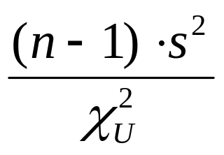
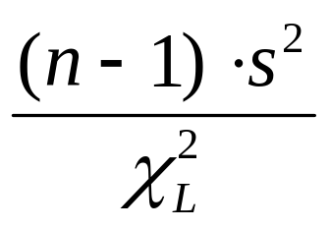



Interval for a Population Variance
Lower Bound, (1-α)% Confidence Interval
Upper Bound, (1-α)% Confidence Interval
where n = sample size
= sample variance
= chi-square value where upper tail area = α/2
= chi-square value where lower tail area = α/2
© 2011 Cengage Learning.
All Rights Reserved. May not be scanned, copied, or duplicated, or posted to a publicly accessible website, in whole or in part.

Slide 24
Chi-Square Test of a Single
Population Variance
The Question:
  Does the value of the sample variance differ from the value of the assumed population variance?
Hypotheses:
  H₀: σ² {=, ≤, ≥} a specific value.
  H₁: σ² {≠, >, <} a specific value.
© 2011 Cengage Learning.
All Rights Reserved. May not be scanned, copied, or duplicated, or posted to a publicly accessible website, in whole or in part.

Slide 25
Chi-Square Test of a Single
Population Variance
Rejection Region:
    Degrees of freedom: df = n – 1
    where n = sample size
Test Statistic:
(
n
–
1
⋅
2
χ
2
=
)
s
σ
2
© 2011 Cengage Learning.
All Rights Reserved. May not be scanned, copied, or duplicated, or posted to a publicly accessible website, in whole or in part.

